Slide 1
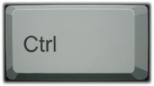
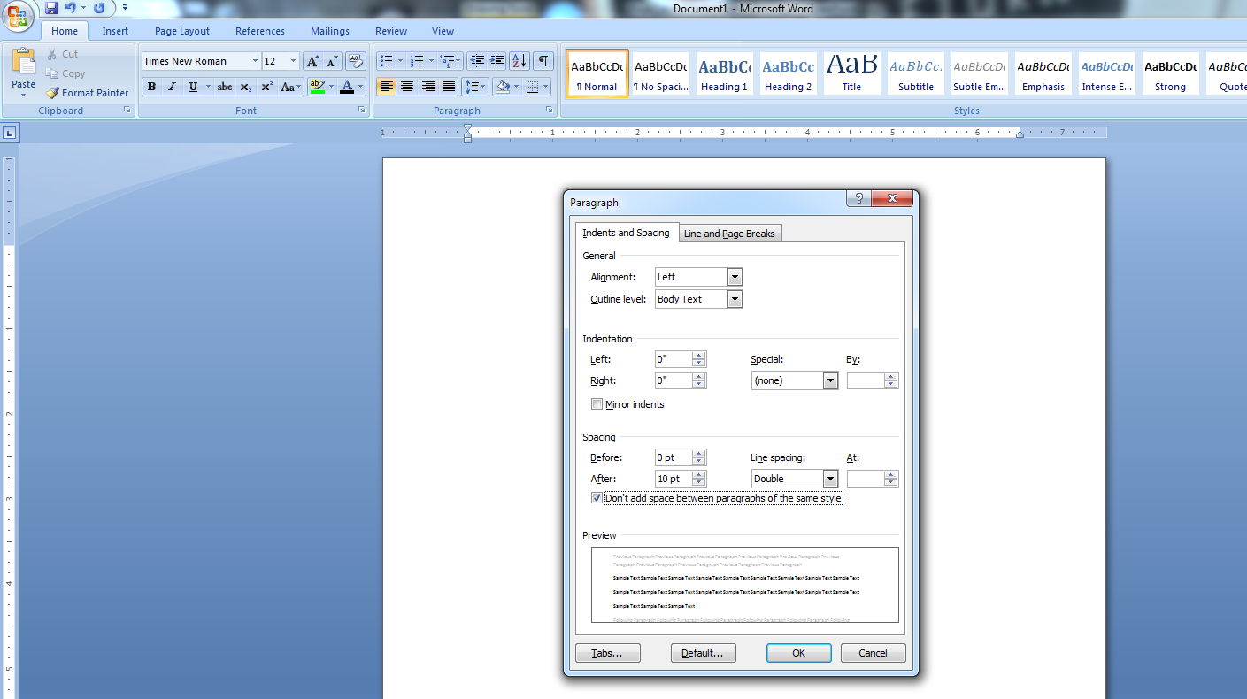
Starting from Scratch: MLA Format
Section A: Spacing and Font
Open a new Microsoft Word document.
2. Hold and press 2 to enable double spacing.
Set font to Times New Roman, size 12.
Ensure there are no extra spaces between paragraphs when you
press the Enter key by checking the box under the paragraph
function.

Slide 2
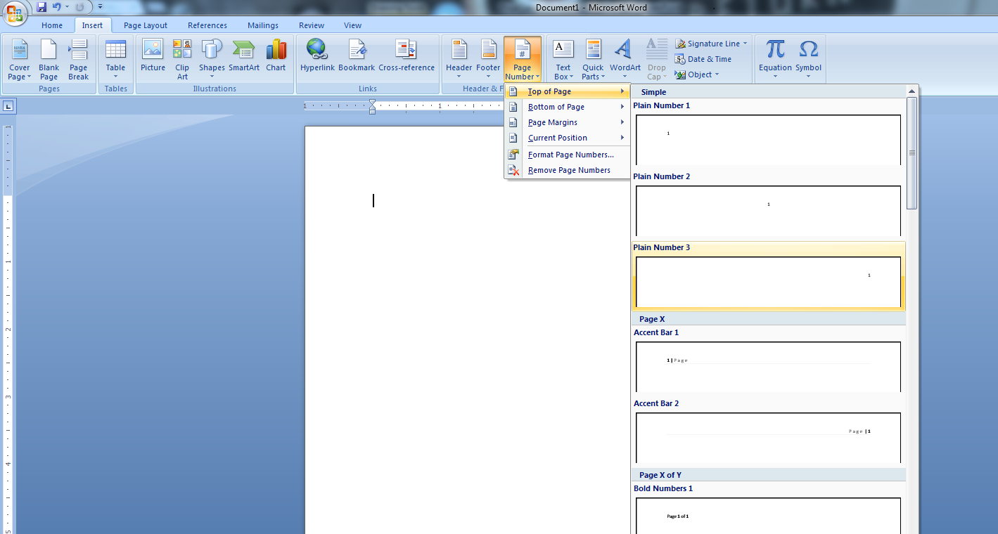
Starting from Scratch: MLA Format
Section B: Page Numbering
Click on the Insert tab, choose page number, top of page,
plain number three (which sets it to page right).
2. When the editing screen appears, type your last name in front
of the number 1. Ensure you add a space between your last
name and the number. Then, highlight all of it and change the
font to Times New Roman 12. Double click in the middle of
your document to return to a normal view.

Slide 3
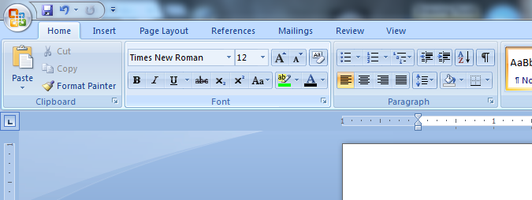
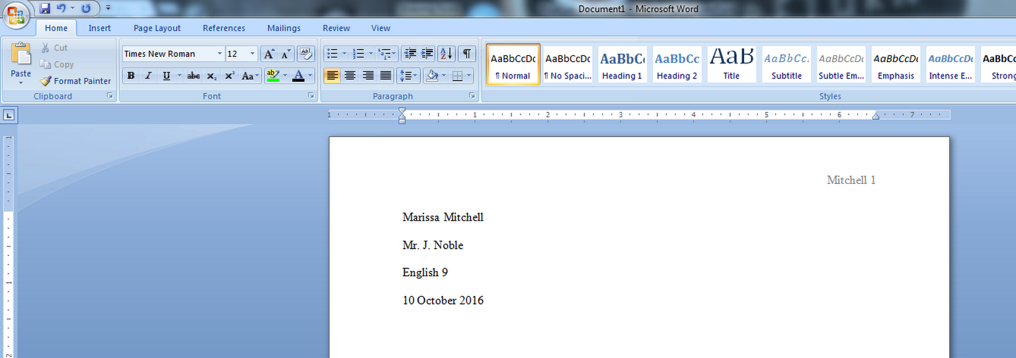
Starting from Scratch: MLA Format
Section C: Paper Heading
Ensure your paper is set to “align text left” (the default
setting).
Hitting enter in between each item, type the following four
items in as your header:
Name
Instructor
Class
Assignment due date (note the day, month, year format)

Slide 4
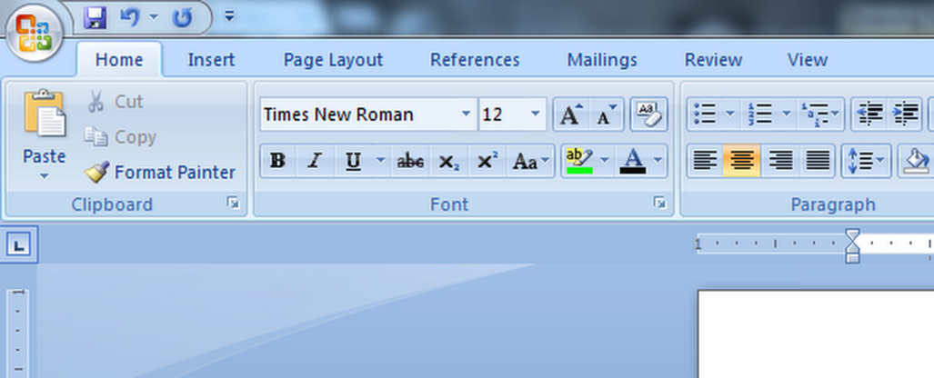
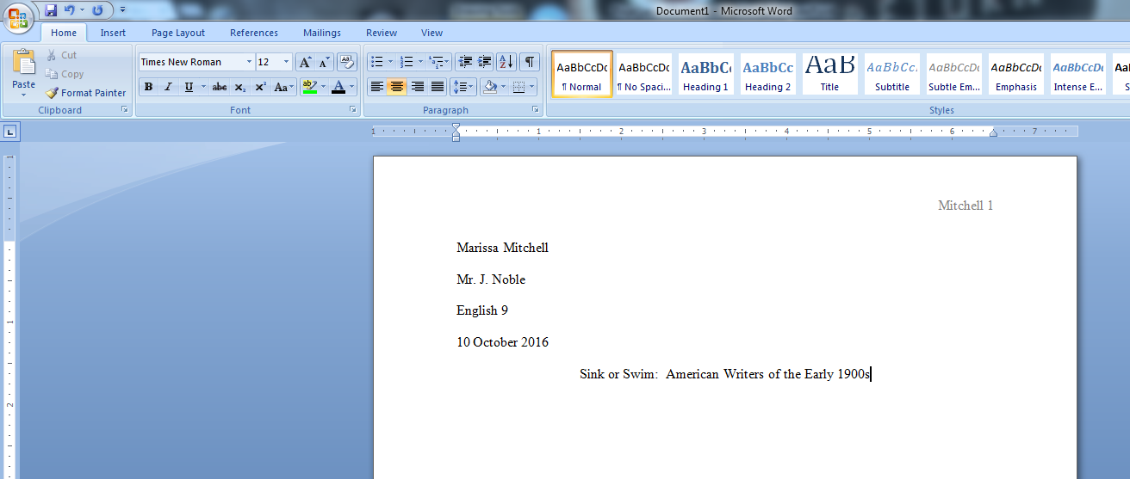
Starting from Scratch: MLA Format
Section D: Title and Typing
After your heading is completed, hit Enter once.
Then, set your paper to “center” text by holding and
pressing E or using the icon.
**note – you should see your cursor move to the center of the page.
Type your title, capitalizing appropriate words. Do not
underline it or make it bold.
Hit Enter once, set your paper back to “align text left,” and
hit the tab key to begin your first paragraph.

